Slide 1

Tornado
Web Frameworks
Basic Handler
Static Content
GET, POST, and more

Slide 2

See Also
http://www.tornadoweb.org/en/stable/
https://www.youtube.com/watch?v=DwrYo_YU9wM
Notes:
Some additional information on concurrency

Slide 3

Python Web Frameworks
Hide the low-level socket/thread details
Some of the popular frameworks:
Django
TurboGears
web2py
Falcon
Flask
We will use Tornado
Command Prompt
C:\> pip install tornado
C:\> python -c "import tornado;print(tornado.version)"
4.5.2

Slide 4
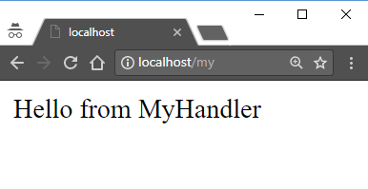
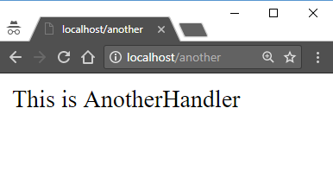
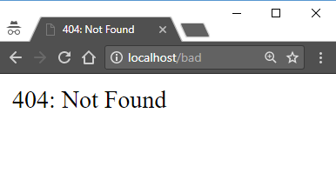
Basic Tornado Server
import tornado.ioloop
import tornado.web
class MyHandler(tornado.web.RequestHandler):
def get(self):
self.write("Hello from MyHandler")
class AnotherHandler(tornado.web.RequestHandler):
def get(self):
self.write("This is AnotherHandler")
handlers = [
("/my", MyHandler),
("/another", AnotherHandler)
]
app = tornado.web.Application(handlers)
app.listen(80)
tornado.ioloop.IOLoop.current().start()
List of Tuples

Slide 5
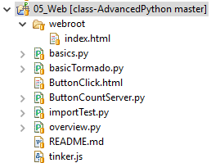
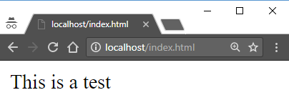
Static Content
# The directory of this module
root = os.path.dirname(__file__)
root = os.path.join(os.path.dirname(__file__), "webroot")
handlers = [
("/my", MyHandler),
("/another", AnotherHandler),
(r"/(.*)", tornado.web.StaticFileHandler, {"path": root}),
]
app = tornado.web.Application(handlers)
app.listen(80)
tornado.ioloop.IOLoop.current().start()

Slide 6
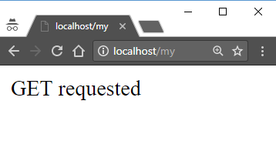
HTTP Verbs and Postman
Traditional browsing sends GETs and POSTs (forms)
Other verbs are used in specialized applications (like REST)
You can code to handle one or more verbs
class MyHandler(tornado.web.RequestHandler):
def get(self):
self.write("GET requested")
def post(self):
self.write("POST requested")
def delete(self):
self.write("DELETE requested")

Slide 7

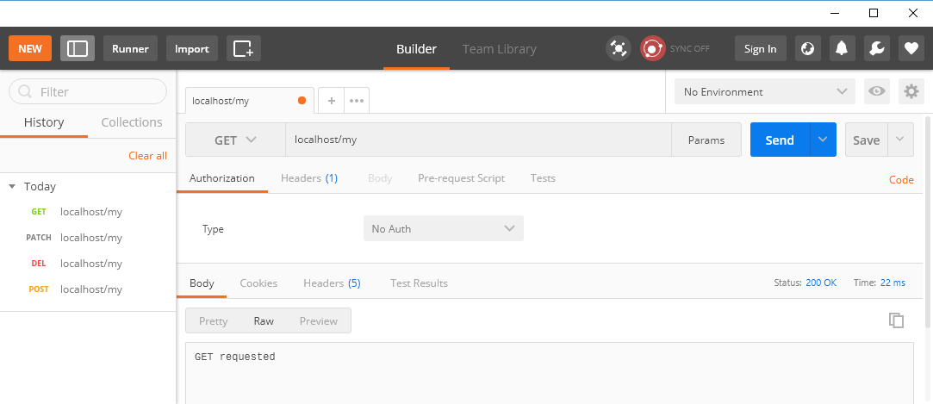
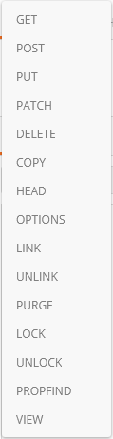
Postman
“Postman” is a Chrome application
Great for testing/debugging HTTP transactions

Slide 8
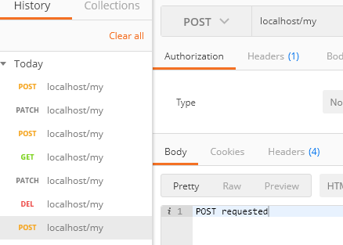

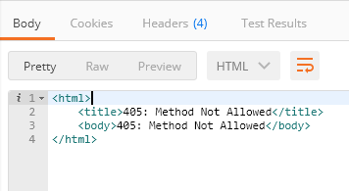
Postman

Slide 9
HTTP Headers
class MyHandler(tornado.web.RequestHandler):
def get(self):
print(self.request)
print(str(self.request.headers))
print(self.request.headers["Accept-Language"])
self.write("GET requested")
HTTPServerRequest(protocol='http', host='localhost', method='GET', uri='/my', version='HTTP/1.1', remote_ip='::1', headers={ ... })
Accept-Language: en-US,en;q=0.8
Accept-Encoding: gzip, deflate, br
Connection: keep-alive
Accept: text/html,application/xhtml+xml,application/xml;q=0.9,image/webp,image/apng,*/*;q=0.8
User-Agent: Mozilla/5.0 (Windows NT 10.0; Win64; x64) AppleWebKit/537.36 (KHTML, like Gecko) Chrome/61.0.3163.100 Safari/537.36
Host: localhost
Cache-Control: max-age=0
Upgrade-Insecure-Requests: 1
en-US,en;q=0.8

Slide 10
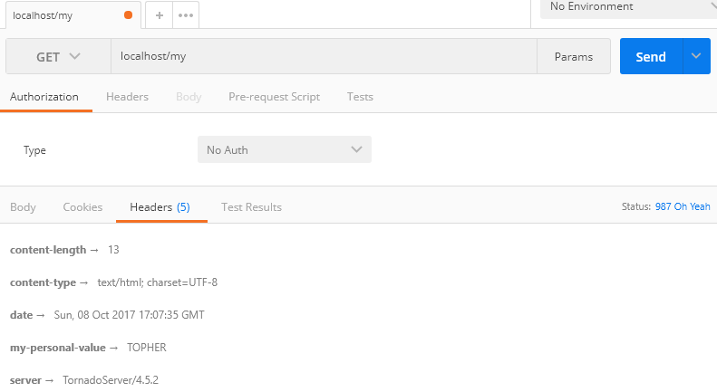
HTTP Headers
def get(self):
print(self.request)
print(str(self.request.headers))
print(self.request.headers["Accept-Language"])
self.set_status(987,"Oh Yeah")
self.set_header("My-Personal-Value","TOPHER")
self.write("GET requested")

Slide 11
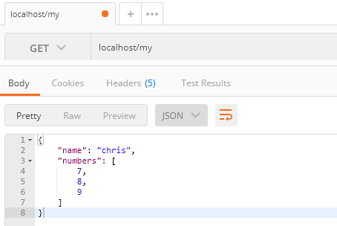
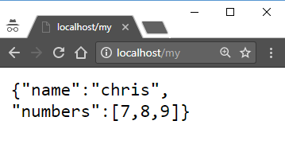
Content Type
def get(self):
self.set_header("Content-Type","application/json")
self.write('{"name":"chris", "numbers":[7,8,9]}')

Slide 12




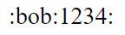


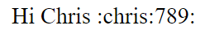
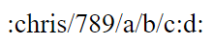
URL Decoding
class DecodeHandler(tornado.web.RequestHandler):
def get(self, first, second):
if (first=="chris"):
self.write("Hi Chris ")
self.write(":"+first+":"+second+":")
handlers = [
("/my", MyHandler),
("/another", AnotherHandler),
("/complex/(.*)/(.*)", DecodeHandler)
]

Slide 13
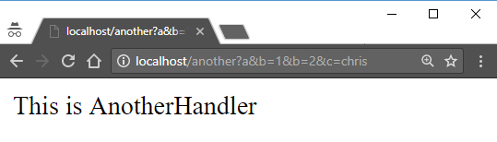
Query Parameters
class AnotherHandler(tornado.web.RequestHandler):
def get(self):
print(":"+str(self.request.arguments)+":")
print(":"+self.get_argument("b")+":")
print(":"+str(self.get_arguments("b"))+":")
self.write("This is AnotherHandler")
{'a': [''], 'c': ['chris'], 'b': ['1', '2']}
:2:
:[u'1', u'2']:

Slide 14
Missing Parameters
get_argument returns this default if the parameter is missing
class AnotherHandler(tornado.web.RequestHandler):
def get(self):
print(":"+str(self.request.arguments)+":")
print(":"+self.get_argument("b", None)+":")
print(":"+str(self.get_arguments("b"))+":")
self.write("This is AnotherHandler")
get_argument raises an exception if the default is not given

Slide 15
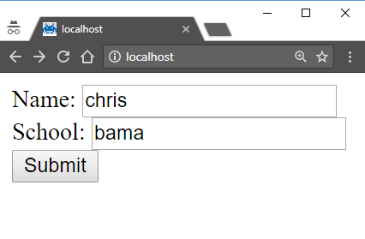
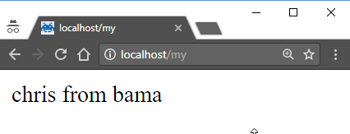
Reading the Request Body
<html>
<form action="my" method="post">
Name: <input type="text" name="name"> <br>
School: <input type="text" name="school"> <br>
<input type="submit">
</form>
</hmtl>
class MyHandler(tornado.web.RequestHandler):
def post(self):
print(self.request.arguments)
print(self.request.body)
self.write(self.get_argument("name")+" from "+
self.get_argument("school"))
{'school': ['bama'], 'name': ['chris’]}
name=chris&school=bama

Slide 16
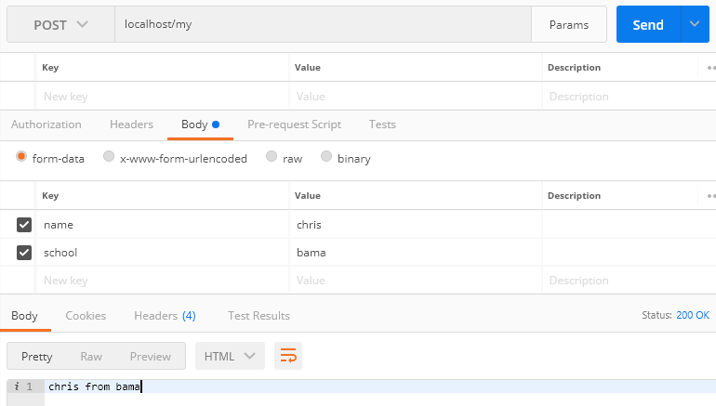
Reading the Request Body

Slide 17

Tinkering
Code up a tornado server that serves out an index.html file with a simple form in it.
The form has two numbers and a submit button.
The server adds the two numbers and returns the output.

